Slide 1

Gokaraju Rangaraju Institute of Engineering and Technology
(Autonomous) Department of Information Technology
A Mini Project on
MEDICAL PRESCRIPTION RECOGNITION
Team Members
(21241A12J7) T.Archana
(21241A12D3) B.Shivani
(21241A12E4) E.Reena
Guide
J. ALEKHYA

Slide 2
Contents
Abstract
Aim and Scope
Existing System
Proposed System
System Specifications
References
Literature Survey
Design
Source Code
Final Output

Slide 3
Abstract
It usually becomes a little difficult for someone to read someone else's handwriting. Similar to this, patients find it extremely difficult to read a doctor's handwriting in a medical prescription. While some medical professionals and the general public may find this problematic, in some cases it leads to incorrect concerns or outcomes because a doctor's handwriting is misinterpreted.A model that can recognize a doctor's handwriting in their prescriptions is created using a convolutional neural network (CNN) based on long short-term memory (LSTM). Input images are segmented using Otsu segmentation and processed to recognize the letters and words using the Deep Convolution Recurrent Neural Network (RNN) to train this supervising model.
Keywords: Medical Prescription Recognition, CNN, LSTM, RNN
Domain: Machine learning, Image Processing

Slide 4
Aim
The aim is to enhance medical prescription recognition by employing machine learning techniques, specifically integrating CNN, RNN, and LSTM with advanced image preprocessing. This approach addresses diverse handwriting styles and layout complexities for improved accuracy and reliability.
Scope
The scope for medical prescription recognition using machine leaming, including CNNS, RNNs, LSTMs, and image preprocessing, lies in significantly enhancing accuracy and efficiency in interpreting diverse handwriting styles and complex layouts in medical documents.

Slide 5
Existing System
Existing systems in medical prescription recognition using machine learning leverage OCR technology and deep learning models like CNNs to digitize and interpret handwritten prescriptions accurately.
Proposed System
A proposed system for medical prescription recognition using the IAM dataset involves preprocessing images, segmenting text lines, extracting features, and using an RNN with LSTM units and a CTC layer for sequence-to-sequence character recognition and error correction.
Improves accuracy in interpreting complex and varied handwriting styles, ensuring more reliable digitization and processing of medical prescriptions.

Slide 6
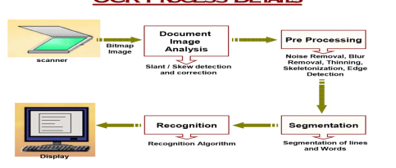
System Architecture

Slide 7
System Specifications
Software
Operating System - Any OS capable of running Python and web browsers (Mac, Windows, Linux).
Front-end - HTML, CSS.
Libraries - OpenCV, Flask.
Languages - Python 3.x.
Tools Required - Anaconda, Jupyter Notebook.

Slide 8
Hardware
Processor –Intel core i5 and above
Memory – 8GB RAM (16GB recommended)
Input devices – Keyboard Mouse
Internet

Slide 9
References
https://www.ncbi.nlm.nih.gov/pmc/articles/PMC9509260
https://www.semanticscholar.org/paper/Medical-Handwritten-Prescription-Recognition-Using-Achkar-Ghayad/3fff5b7c44431728c6cd36b7a164697c02d83acc
https://ieeexplore.ieee.org/document/9609390

Slide 10
Literature Survey

Slide 11
Title | Author & Year of Publication | Objectives | Gaps Identified | Methodology | Result
Doctor’s Cursive Handwriting Recognition System Using Deep Learning | L. J. Fajardo 2019 | The objective is to develop a hybrid model for web and mobile applications to effectively identify and convert doctors' cursive handwritten prescriptions into normal text. | Low accuracy | The study used a CNN and RNN hybrid model in web and mobile apps, tested on 540 prescription images and validated with 48 samples for mobile accuracy. | Out of 540 prescription images, the hybrid model achieved a 72% accuracy rate, recognizing 389 images. The second validation with 48 samples showed a 35% accuracy rate for the mobile application.
Handwritten Text Generation via Disent and led Representations | X. Liu, G. Meng, S. Xiang and C. Pan 2021 | The model aims to use data augmentation to enhance handwritten text recognition (HTR) and achieve state-of-the-art performance in handwritten text generation. | Complexity and computed cost | Decoupling mechanism | Can generate handwritten text images with specified contents and various styles to perform data augmentation

Slide 12
Title | Author & Year of Publication | Objectives | Gaps Identified | Methodology | Result
An OCR Post Correction Approach Using Deep Learning for Processing Medical Reports | Srinidhi Karthikeyan ,Alba G. Seco de Herrera , Faiyaz Doctor , Senior Member, IEEE, and Asim Mirza. 2022 | Addressing OCR challenges, a self supervised pre-training technique, RoBERTa is proposed significantly reducing word error rates in processing real medical documents. | Dependency on specific datasets, potential challenges with uncommon medical terms, and ongoing adaptation needs for diverse medical contexts. | OCR post processing includes space removal, entity filtering, and identification/ masking of incorrect words for improving accuracy. | The project automates NHS patient report information retrieval by categorizing medical documents, identifying key modifications, and recommending updates for immediate inclusion in patient records.
An online cursive handwritten medical words recognition system for busy doctors in developing countries for ensuring efficient healthcare service delivery | ShairaTabass um1*, NurenAbedin 1 , Md Mahmudur Rahman2 , Md Moshiur Rahman3 , MostafaTaufq Ahmed4 , Rafqul Islam2,5 & AshirAhmed1, 2. 2022 | Enhance healthcare in developing countries with machine learning for accurate handwritten prescription recognition and a smartpen for real-time digitization, reducing errors and costs. | Single Language conversion | Data augmentation using RSS | The proposed handwritten recognition technology can be installed in a smart pen for busy doctors which will recognize the writings and digitize them in real time.

Slide 13
Title | Author & Year of Publication | Objectives | Gaps Identified | Methodology | Result
Doctor’s Handwritten Prescription Recognition System In Multi Language Using Deep Learning | Pavithiran G1 , Sharan Padmanabha n2 , Nuvvuru Divya3 , Aswathy V 4 , Irene Jerusha P5 , Chandar B6 2022 | The system using several networks CNN, RNN, LSTM to recognize and translate handwritten prescription s to various languages. | The proposed system cannot be applied for all the systems. | Data collection, Data Processing, Model Building, Prediction readable prescription. | The model went around 50 epochs to get trained and further more predicted text was compared with medical database.
Natural Language Processing and Computer Vision in Healthcare :Doctor’s Handwriting Recognition | Mehee Porwal Mitesh Khemani. 2023 | Create a CNN to improve medical record accuracy by detecting doctors' handwriting. Train with diverse data and extend to finance and postal services for better handwriting recognition. | Performance depends on data quality. Challenges include limited medical expertise, reliance on technology, interpretability issues, and ethical concerns like privacy and bias. | Integrate AI for accurate diagnosis, validate algorithms in real-world scenarios, and embed them into clinical workflows. Provide staff training and ensure continuous improvement for optimal patient care. | Improved handwriting recognition and precise Healthcare diagnosis via machine learning enhance efficiency and cut costs.

Slide 14
Design

Slide 15
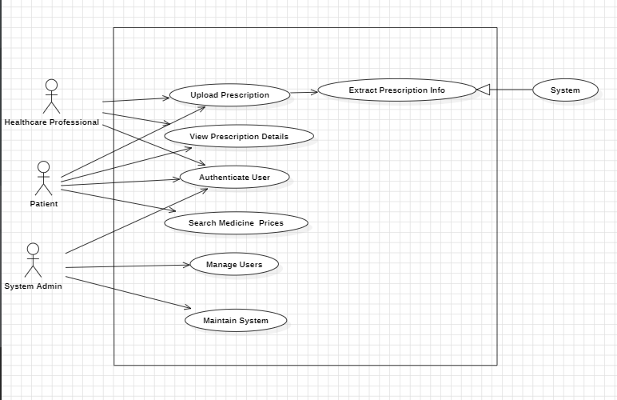
USECASE DIAGRAM

Slide 16
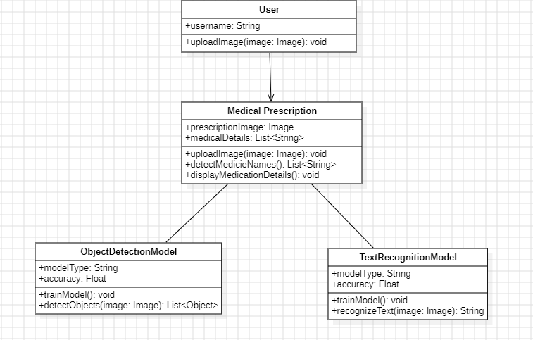
Class Diagram

Slide 17
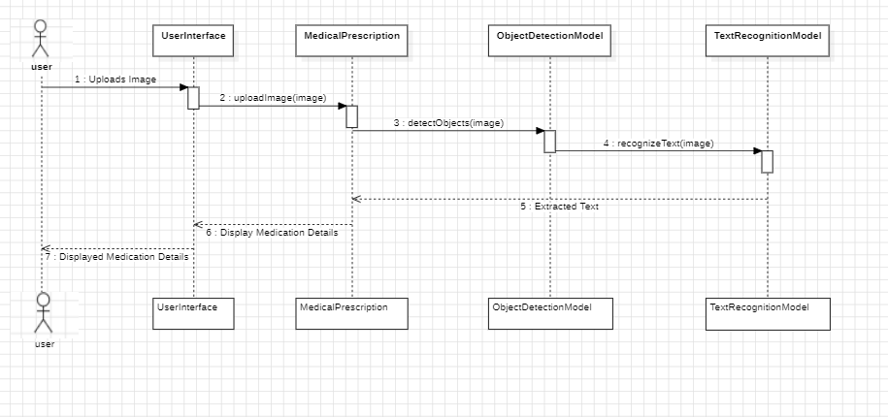
Sequence Diagram

Slide 18
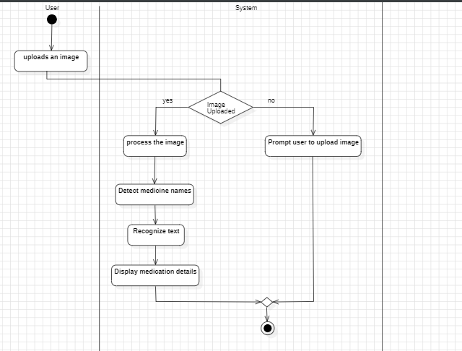
Activity Diagram

Slide 19
Source Code

Slide 20
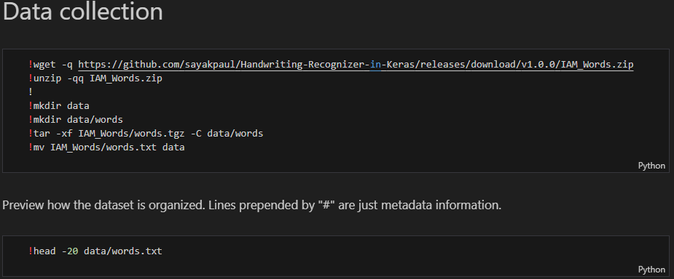
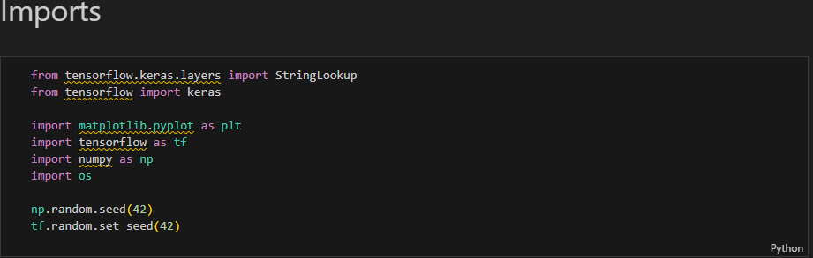
Data Collection
Importing Modules and Packages
Importing Modules and Packages

Slide 21
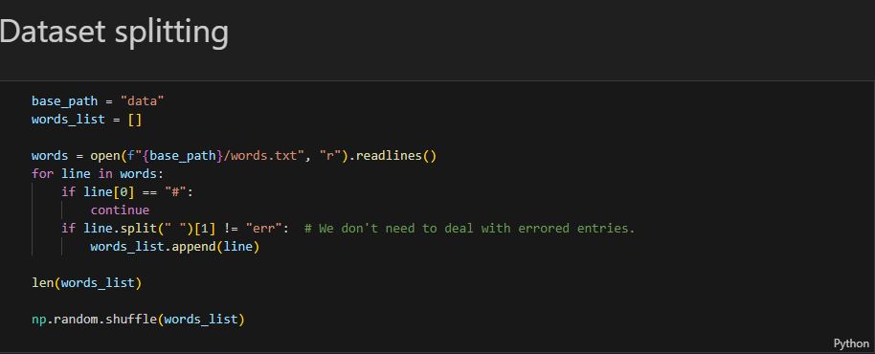
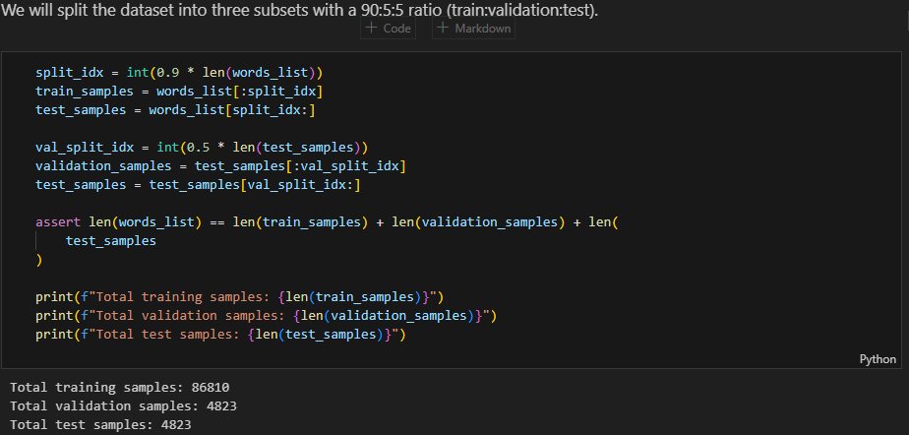
Dataset Splitting

Slide 22
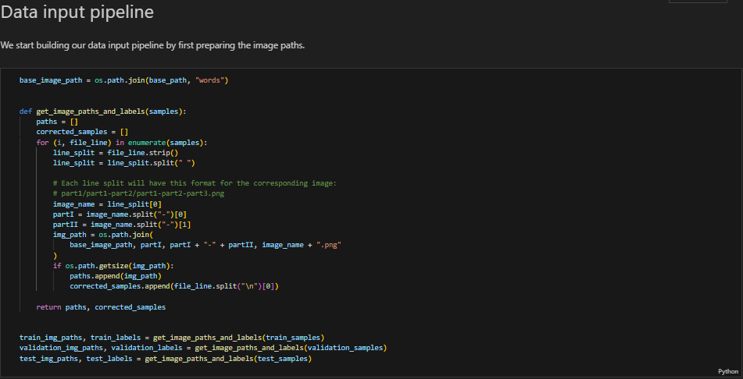
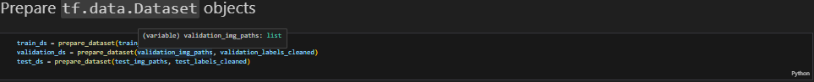
Data Input Pipeline
Prepare Dataset Objects
Prepare Dataset Objects

Slide 23
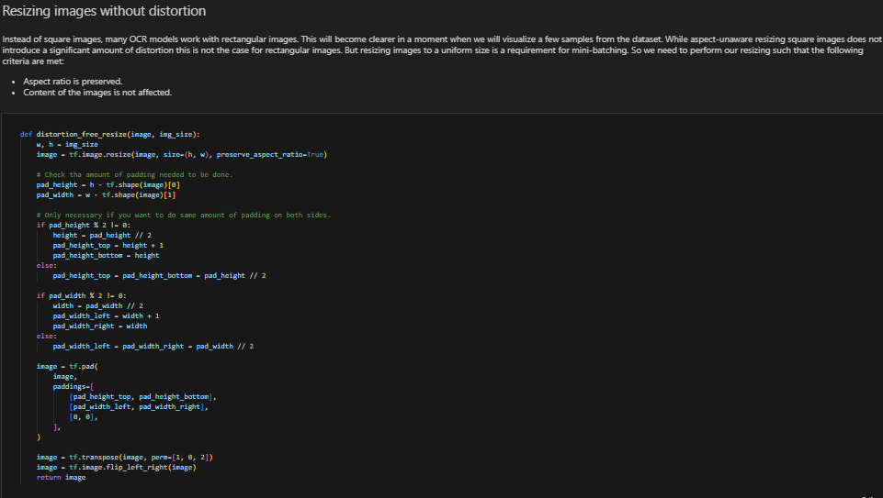
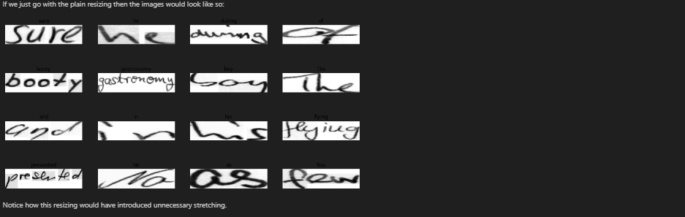
Resizing Images without Disortion

Slide 24
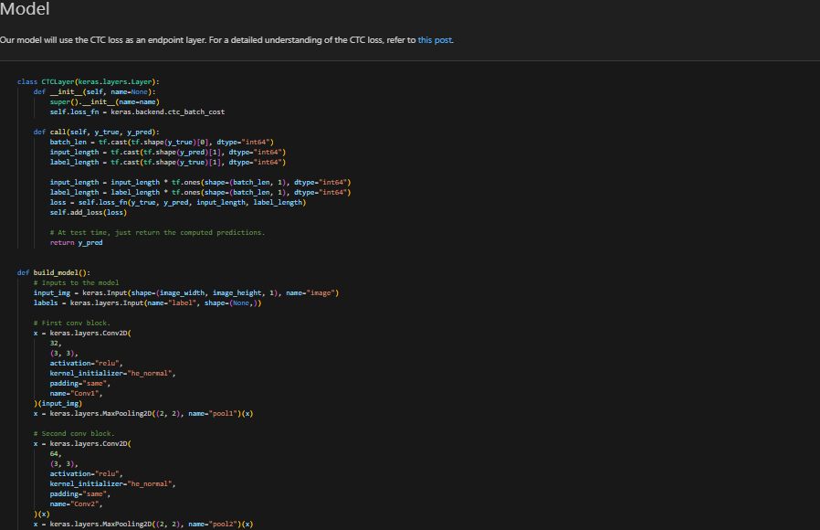
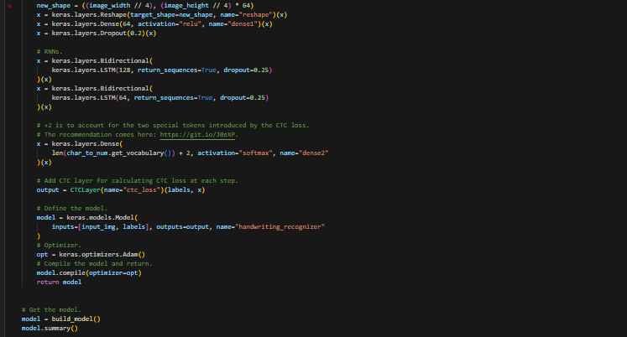
Model

Slide 25
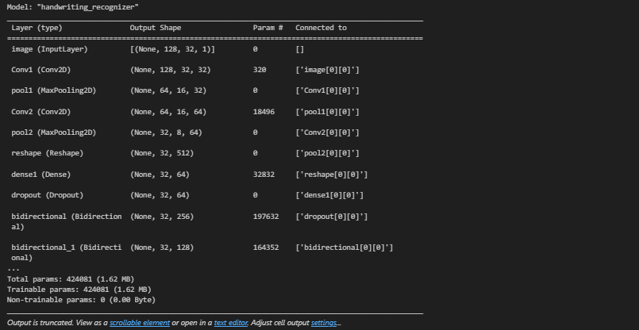
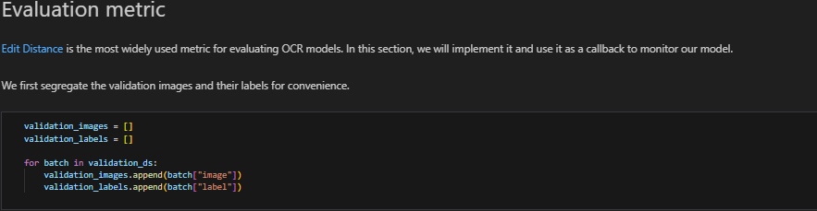
Evaluation Metric

Slide 26
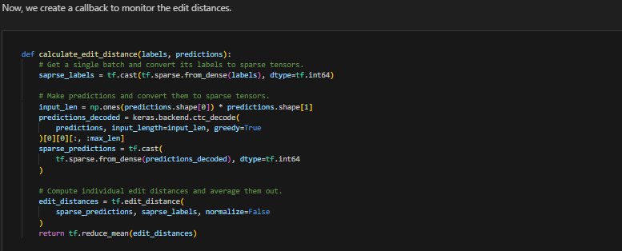
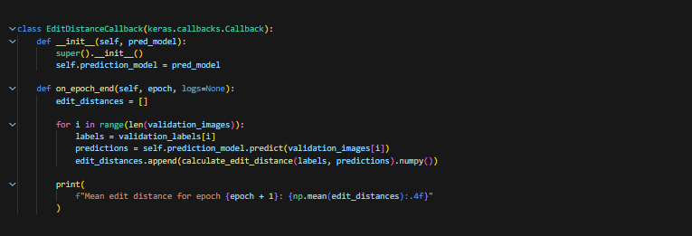

Slide 27
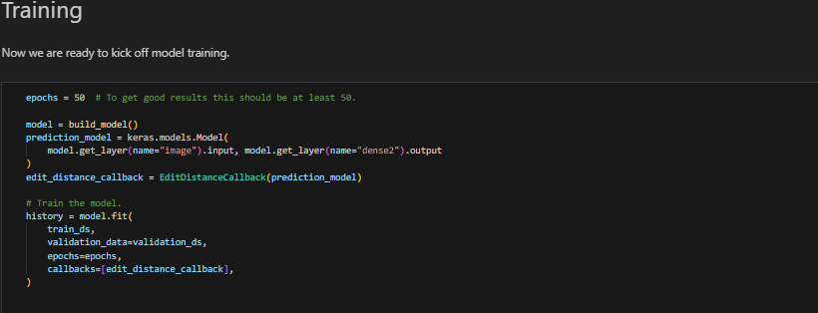
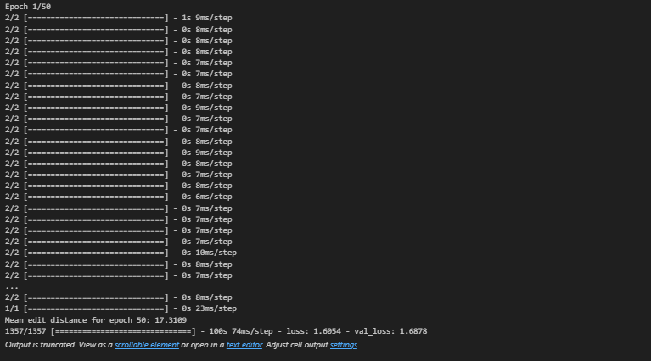
Training

Slide 28
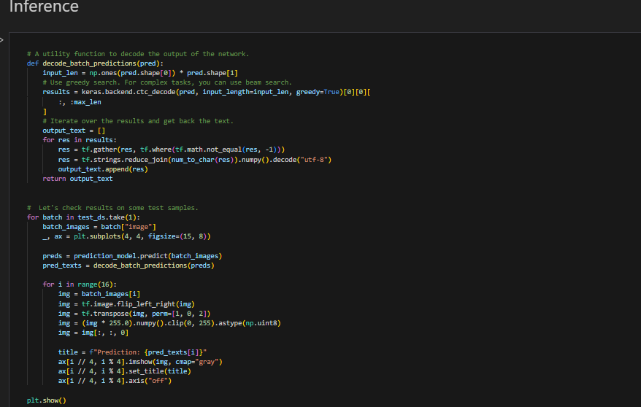
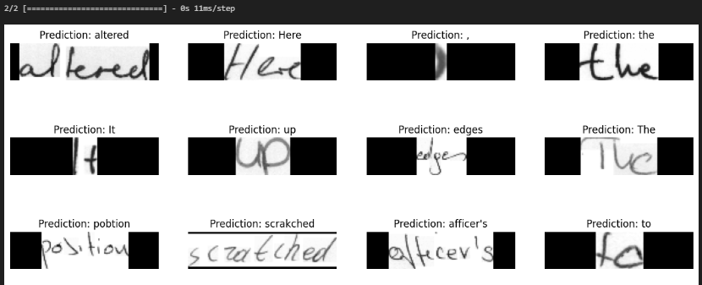
Inference

Slide 29
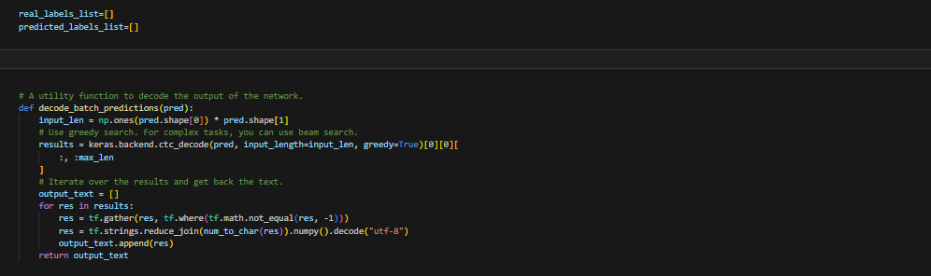
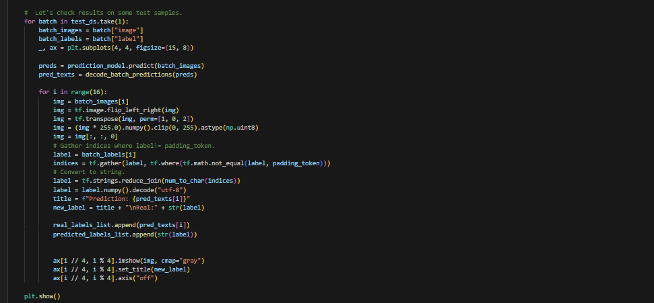
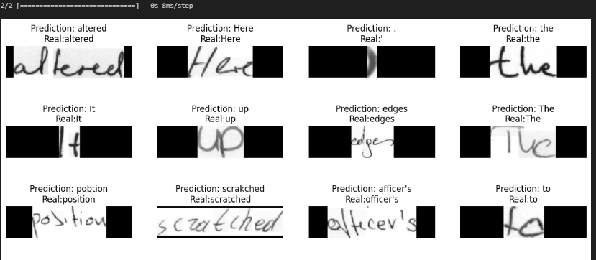

Slide 30
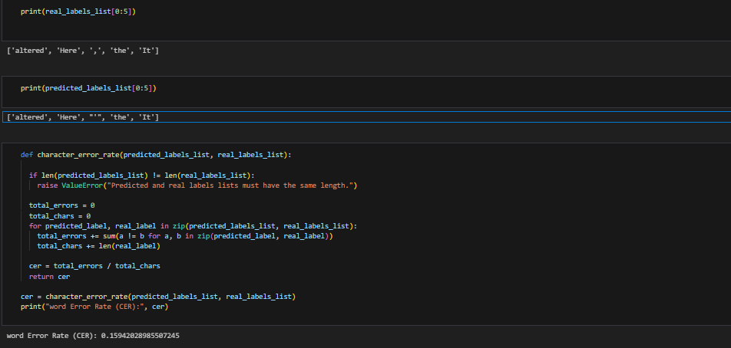
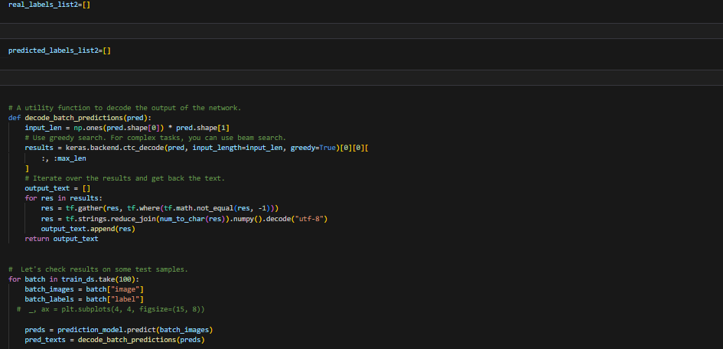

Slide 31
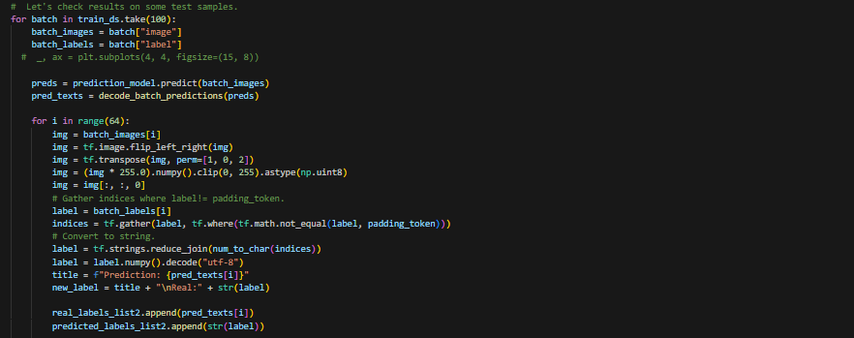
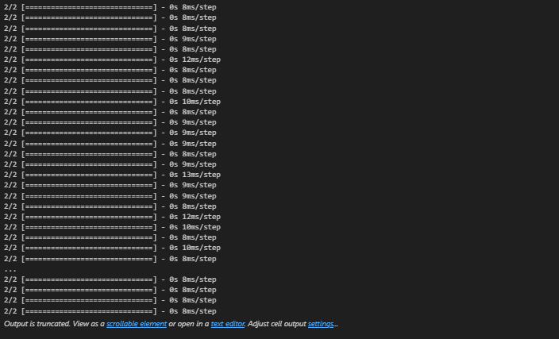

Slide 32
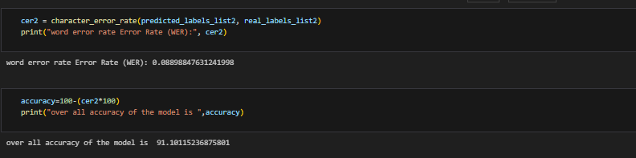

Slide 33
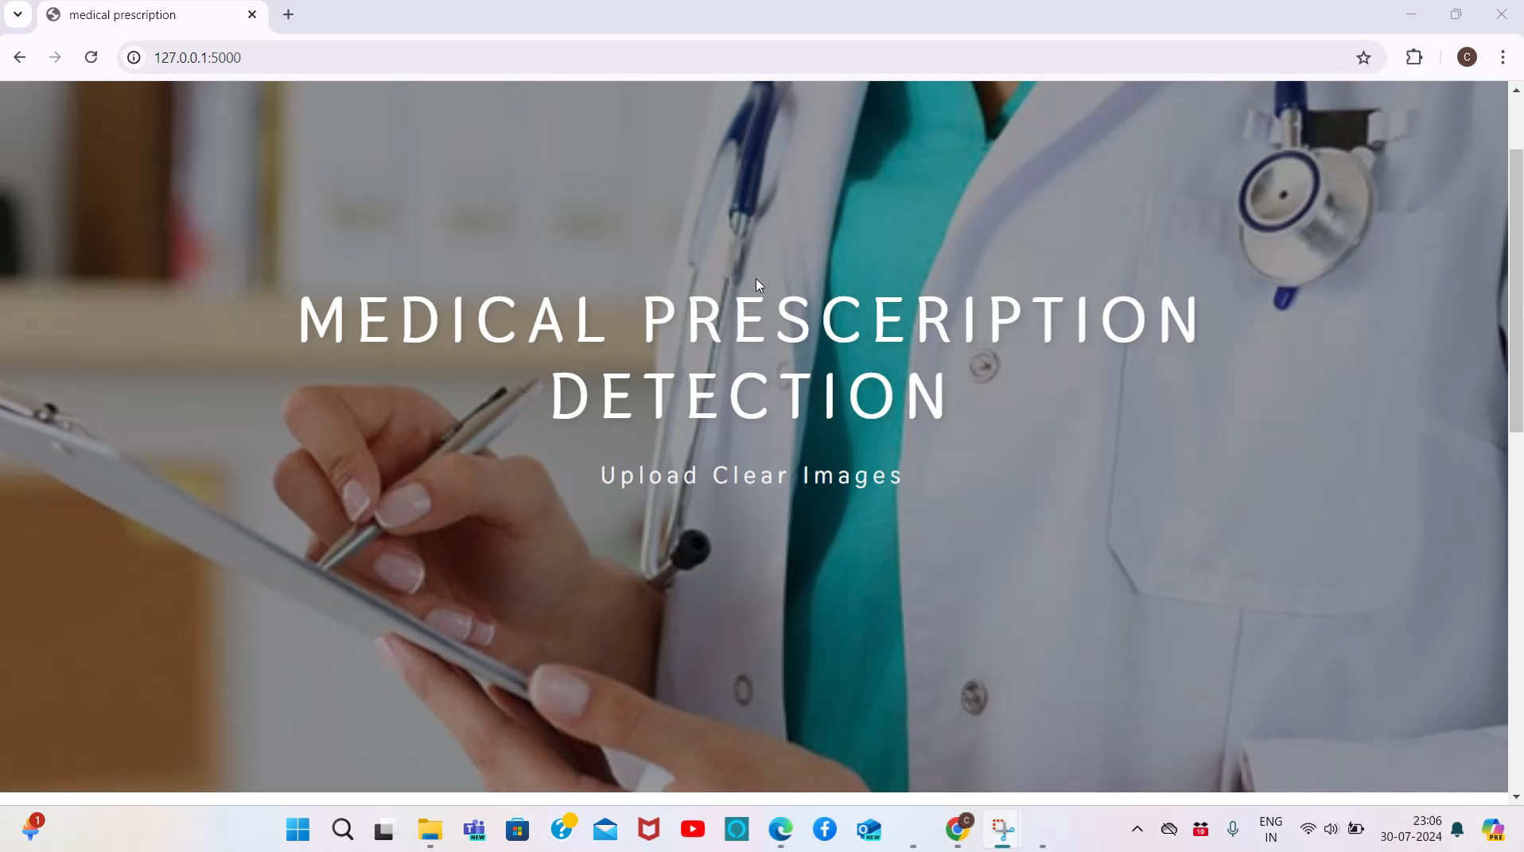

Slide 34
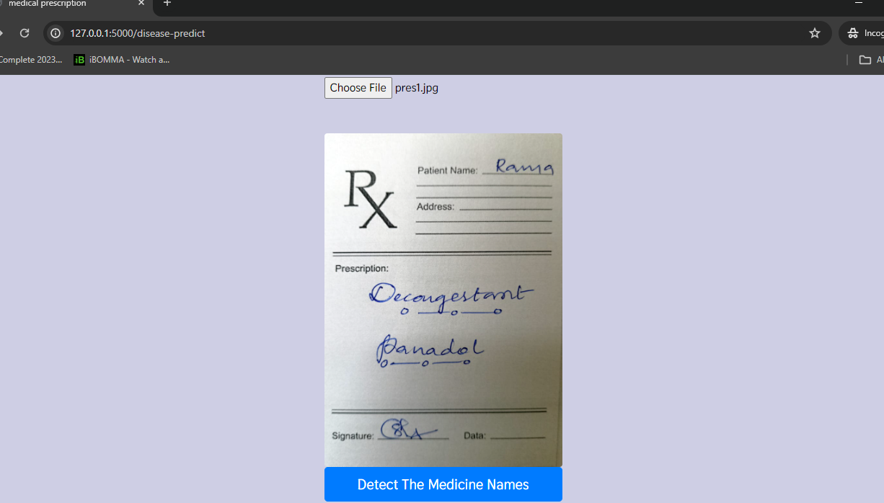
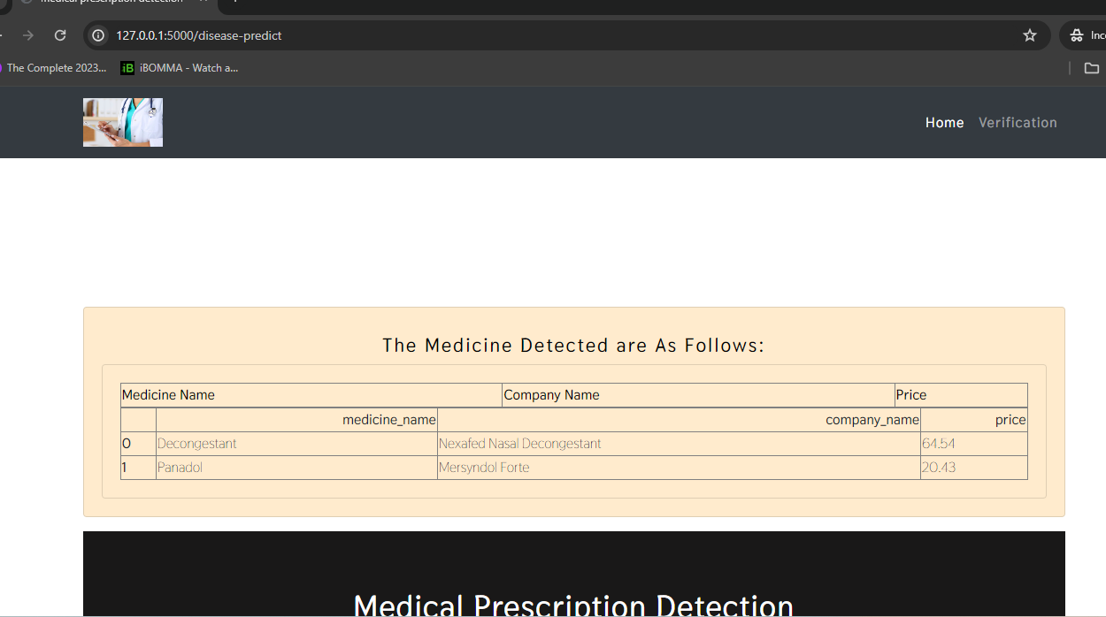
Final Output:

Slide 35
THANK YOU

